Slide 1
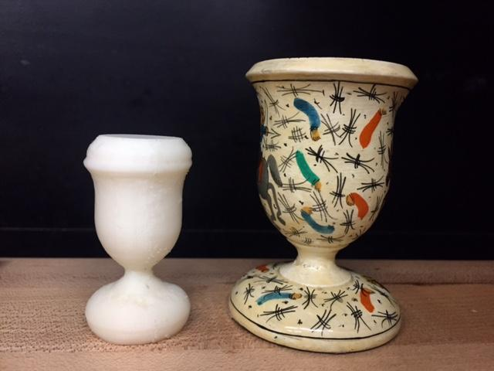
Scanner for Automated 3D Modeling of Small Objects
Group B CREOL
Cary McEwan CPE
Sommer Hilliard EE
Isaias Velez EE
Sam Benjamin PE
Notes:
Introduce ourselves first, then the project

Slide 2
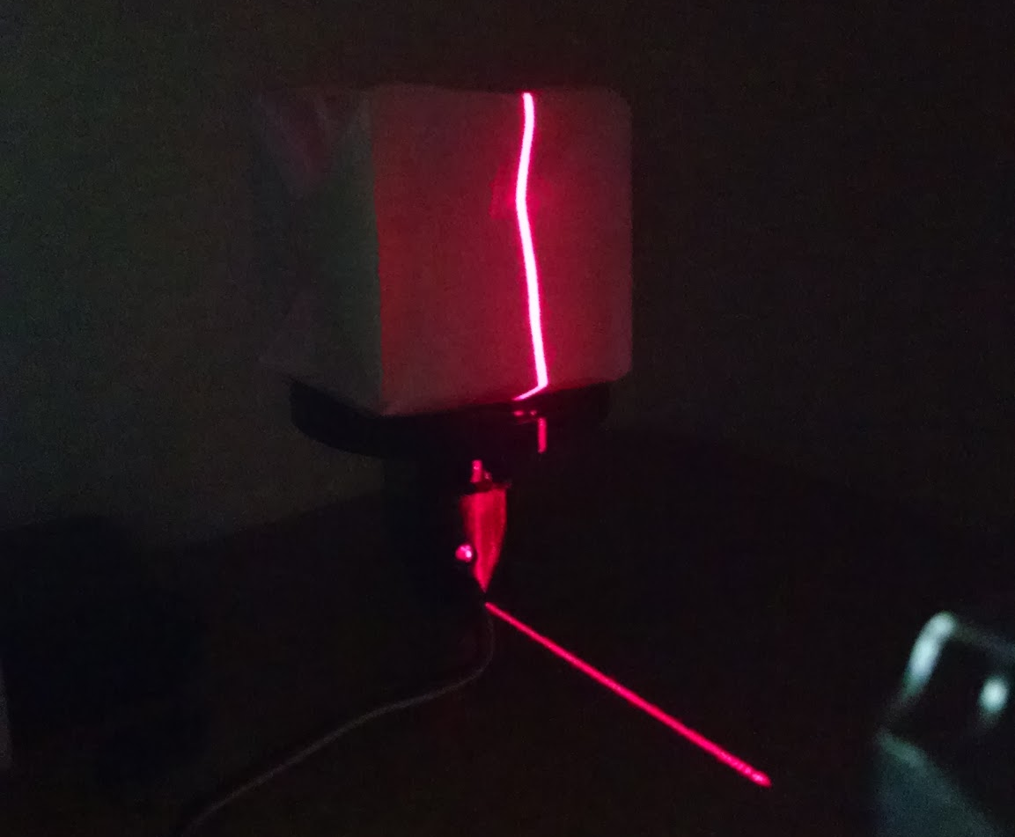
Motivations
3D printers are becoming popular, and the demand for 3D scanners isn’t far behind
3D modeling software is expensive and difficult to learn
Countless applications for hobbyists and creative types
Notes:
Sam

Slide 3
Specifications
Parameter | Specification
Maximum Scan Time | 10 minutes
Enclosure Dimensions | 50x20x13 cm
Weight | ~5 lbs
Deliverables | Ready-to-print .stl & .ply files
Production Cost | $274
Notes:
Sam

Slide 4
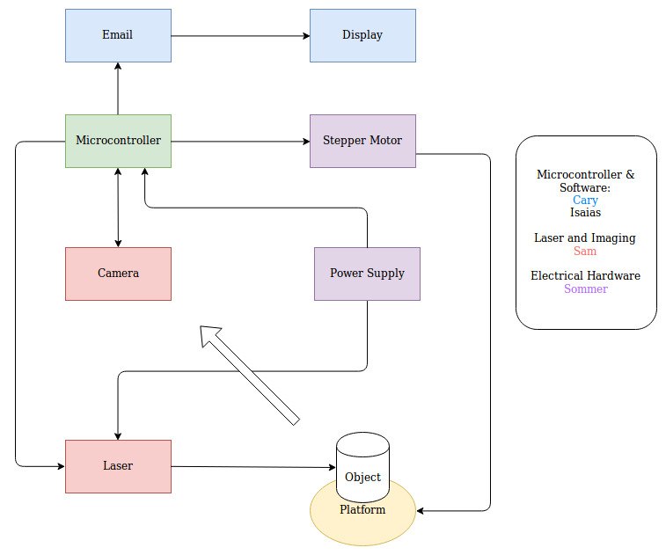
Project Block Diagram
Notes:
Isaias

Slide 5
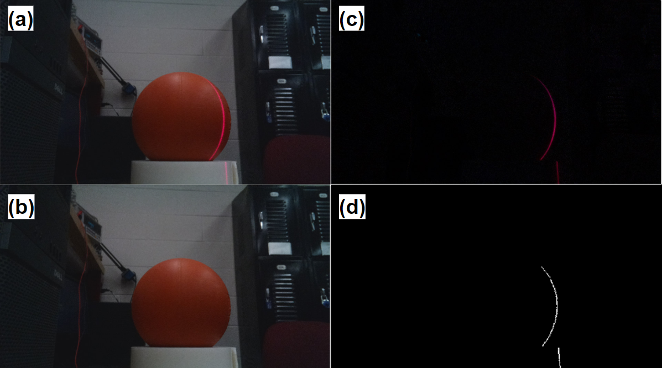
Raw Images & Processing
An image is captured with laser illumination active.
A reference image of the scene is captured with no laser illumination.
Image subtraction isolates laser line.
A maximum intensity value is found in each pixel row and its location is indexed for point cloud storage
Notes:
Sam

Slide 6
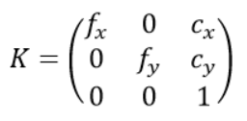
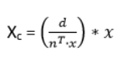


Point Cloud Generation: Old Approach
Intrinsic Calibration
Extrinsic Calibration: Laser Plane
Extrinsic Calibration: Turntable
Express Points in Global Coordinates
Obtain Camera Matrix
Define Laser Plane
Define Turntable Coordinate System
Rotate into Place

Slide 7
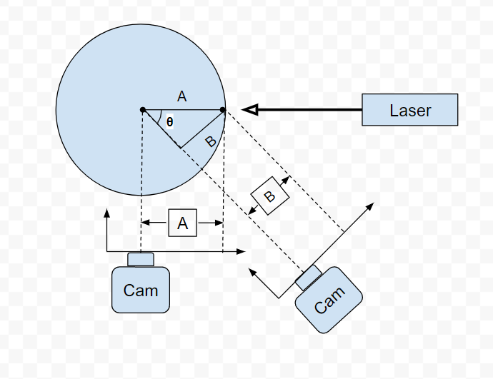
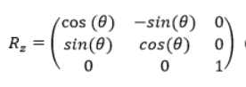
Point Cloud Generation: New Approach
Stretch Segmented Laser Line
Rotate About Platform Center
Scaling Constant
A = (B/sinθ) = S_{t}*B
S_{c} = 0.088
Center defined in terms of pixels. This is determined through trial and error.
S_{t} = (1/sinθ) = 1.55

Slide 8
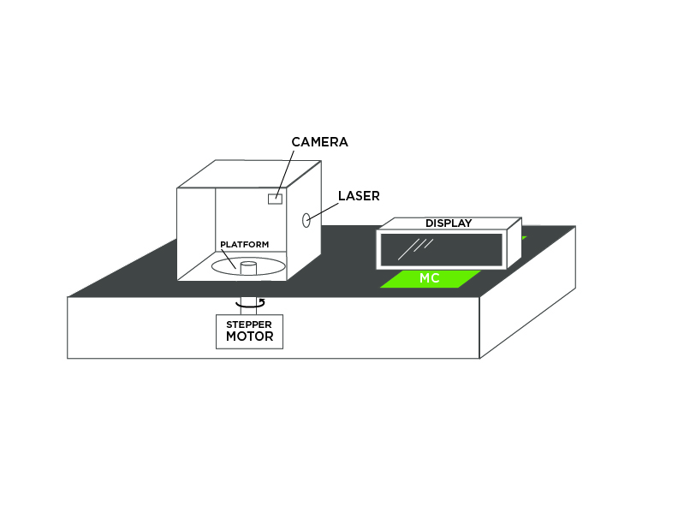
Initial Prototype Design
Notes:
Isaias

Slide 9
Platform and Base
Medium Density Fiber (MDF)
  Low Cost
  Light material
  Fast design iterations with CNC machine
Dimensions:
  Camera-to-platform center: 250mm
  Base: 500mm x 200mm
  Camera-to-laser: 135mm
Vibrational Interference
  Mounting screws -> increased vibrations on platform while rotating
Heat Shedding:
  Mounted heat sinks and open-air design

Slide 10
Meshing
Post point cloud processing in Meshlab server
  *.mlx scripts
Poisson Disk Sampling
  Takes sample of dense point cloud and creates poisson disks around the cloud
  Improves calculation using subsample
Compute vertex normals
  Nearest Neighbor Search (100+)
Poisson Reconstruction
  Uses octrees to sample points recursively divided into 8 octants

Slide 11
Software Implementation
Python scientific computing stack
  Numpy -> C/C++/ Fortran bindings for fast matrix operations
OpenCV
  C++ binding for Python
Software compensation for hardware issues
  Open Design due to image and channel subtraction
  Vibrational interference
  Misalignment
  System Synchronization

Slide 12
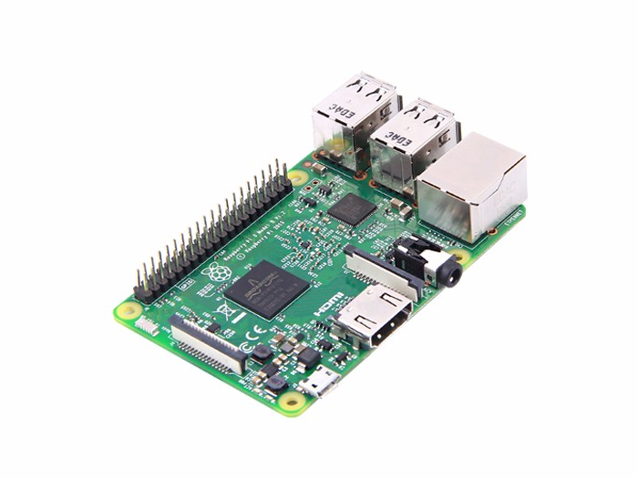
Raspberry Pi 3 Model B
 |  | Arduino UNO | Raspberry Pi Model A | Raspberry Pi 3 Model B | BeagleBone Black
Power Consumption | Operating Voltage (V) | 5 V | 5 V | 5.1 V | 5 V
 | DC Current (mA) | 46.5 mA | 500 mA | 1000 mA | 1200 mA
 | Power Consumption (mW) | 232.5 mW | 2500 mW | 5100 mW | 6000 mW
Cost | System Price ($) | $20 | $25 | $35 | $53
 | Budget Percentage (%) | 9.5% | 11.9% | 16.7% | 25.2%
Memory | RAM | 2 KB SRAM | 256 MB SDRAM | 1 GB SDRAM | 512 MB DDR3
I/O Potential | GPIO Pin Count | 14 | 8 | 40 | 65
Clock Rate | Clock Rate | 16 MHz | 700 MHz | 1.2 GHz | 1 GHz
1 GB SDRAM
Onboard HDMI
No code size limitation
Extensive developer community
$35
Notes:
Cary - For our microcontroller, or moreso embedded processing unit, we opted for the Raspberry Pi 3 Model B. Some important specs for our system include its 1.2 GHz clock rate and 1 GB SDRAM a which will be necessary for processing point cloud data while also remaining within the 10 minute time constraint specified in the specification. The 40 GPIO pins allow for a ton of input/output potential. The onboard HDMI allows us to directly connect to our display. Some other cool features include its virtual lack of code size limitation and extensive developer community. The combination of its sufficient power consumption, extensive memory capacity, significant input/output potential and exceptional clock rate, all at a price of $35 made the Raspberry Pi an easy choice for our embedded processing unit.

Slide 13
Development Environment
Language(s): Python
IDE(s): Pycharm, Spyder
OS: Linux (Raspbian)
Version Control: GitHub
Development Model: Agile
Notes:
Cary - For our software development environment, we’ll be coding primarily in Python. For that we’ll be using Jetbrains’ Pycharm as well as Spyder for fast matrix operations. The operating system that we’ll be using, which has long been installed on our Raspberry Pi, is Raspbian which is a distribution of Linux. This is extremely useful as there’s a ton of support available due to the amount of Raspberry Pi users that opt for this operating system. For our version control, we’ll be using the popular GitHub, just to make sure no data is loss and allow for the most efficient software development process. As a result of this, we implemented the agile model, focusing on keeping each other updated on our existing progress and crossing off tasks as we went.

Slide 14
Device Communication
Notes:
Cary - Another extremely important function of the Raspberry Pi in our system is communicating with the other devices. Serving as the brain of the system, the Raspberry Pi is responsible for telling the stepper motor when to step, the camera when to capture an image and the laser when to illuminate.

Slide 15
Device Communication
Stepper Motor Driver
RPi.GPIO Python Library
  Provides control of each of the 40 GPIO Pins
Steps taken based on rising edge clock.
Simulate this by toggling the pin from off to on.
Notes:
Cary - For communicating with the stepper motor driver, we opted for the RPi.GPIO python library. This library isn’t specific to the stepper motor driver, it actually is a relatively general library that provides control of each of the 40 GPIO pins to users. The stepper motor used in our system operates on a rising edge clock. This is simulated by sending a signal of 0 to that pin and then a signal of 1. This essentially toggles it from off to on, where the step is taken at the point shown in the diagram. Though in an ideal situation, the step is taken immediately at the corner of that edge, in practice there is perhaps a nanosecond degree of delay between the transmission of the signal and the motor’s response.

Slide 16
Device Communication
Laser
RPi.GPIO Python Library
Signal of 1 → Laser ON
Signal of 0 → Laser OFF
Facilitates Image Subtraction
Notes:
Cary - Similar to the Stepper Motor Driver, the RPi.GPIO Python Library is also used for communicating with the laser. Unlike the stepper motor driver, however, the laser does not operate on a rising edge clock. When sent a signal of 1, the Laser will turn/remain on. Only when sent a signal of 0 will the laser turn off. This is needed to facilitate the image subtraction, which requires capturing an image with the laser on and one with the laser off.

Slide 17
Device Communication
Raspberry Pi Camera
PiCamera Python Library
Connected directly to camera port vs. GPIO Pin
Capture: Take picture.
Notes:
Cary - For handling communication with the Raspberry Pi Camera, we opted for the PiCamera Python Library. This was actually one of the major benefits of selecting the Pi Camera, this library that offers direct support. Note that we didn’t use the RPi.GPIO library because the Camera is connected directly to the camera port as opposed to a GPIO Pin. The primary functions that the library offers are a Preview which shows users what the camera sees (similarly to how one operates on a smartphone) and a capture which simply takes the picture.

Slide 18
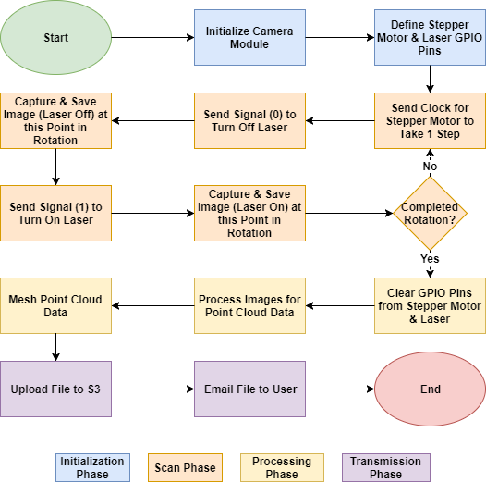
Device Communication
Flow Chart
Notes:
Cary - Communication Flowchart

Slide 19
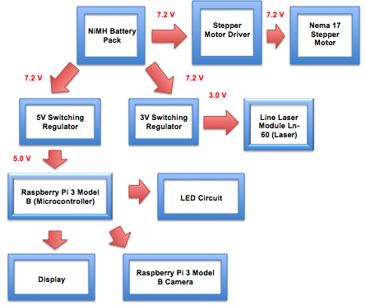
Power
Flow Chart

Slide 20
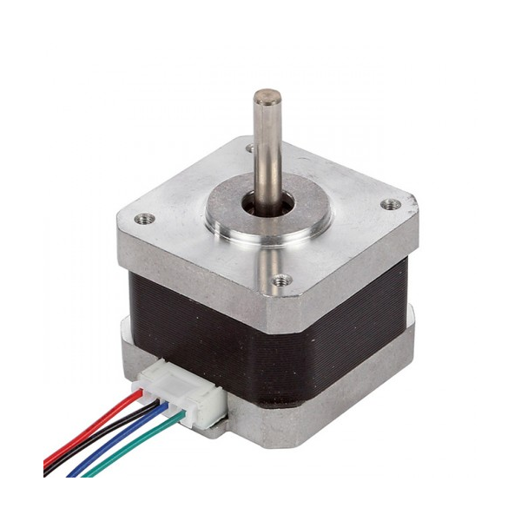
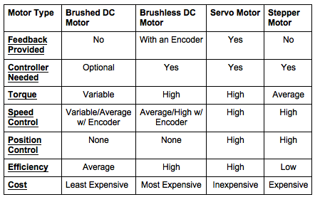
Stepper Motor
NEMA 17 Stepper Motor
2 phase
750 mA/phase
400 - 3200 steps/rev
Precise position & speed control
High low speed torque
Notes:
Sommer
The greater number of poles allows a stepper motor to move accurately and precisely between each pole and allows a stepper to be operated without any position feedback for many applications
With a stepper motor, a single drive pulse will move the motor shaft one step, from one pole to the next. Since the step size of a given motor is fixed at a certain amount of rotation, moving to a precise position is simply a matter of sending the right number of pulses.

Slide 21
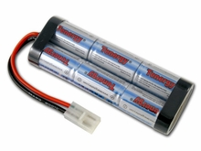
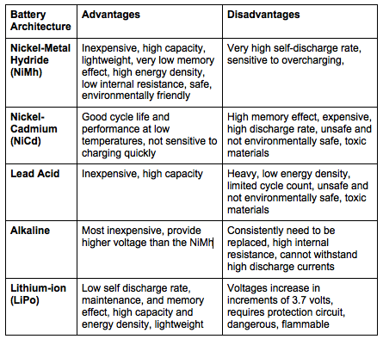
NiMh Battery
7.2V
5000mAh
Charged at rate of 2A in 200mins
Lightweight
No memory cell effect
Inexpensive

Slide 22
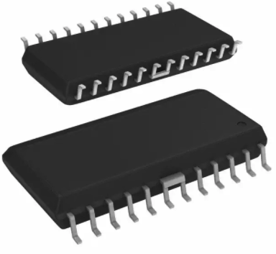
Stepper Motor Driver Chip
Allegro A3967 Microstepping Driver
10.3mm
24 pin package
Full, half, quarter, and eighth step modes
750mA, 30V output rating
Supply voltage 3.3V to 5V
15.4mm

Slide 23
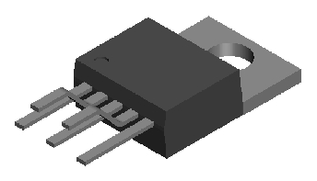
Switching Regulator
10mm
LM2576-ADJ
Capable of driving 3 amp loads
Maximum output ripple voltage - 50mV
Adjustable output and high efficiency
15mm

Slide 24
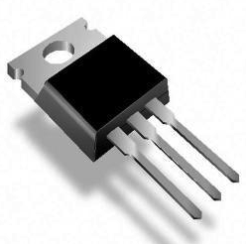
N-Channel Mosfet
10.3mm
15.8mm
IRFZ44N
Low on-resistance
Fast switching speed
Highly efficient and reliable

Slide 25
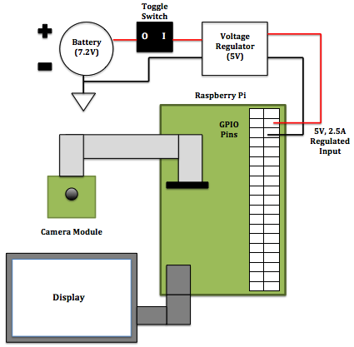
Microcontroller Subsystem
Battery
Switch
5V Switching Regulator
Raspberry Pi
Camera Module
Display

Slide 26
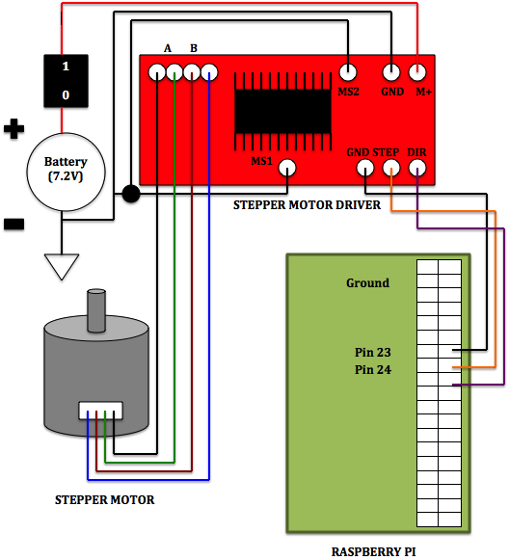
Stepper Motor Subsystem
Battery
Switch
Stepper Motor Driver
Stepper Motor
Raspberry Pi

Slide 27
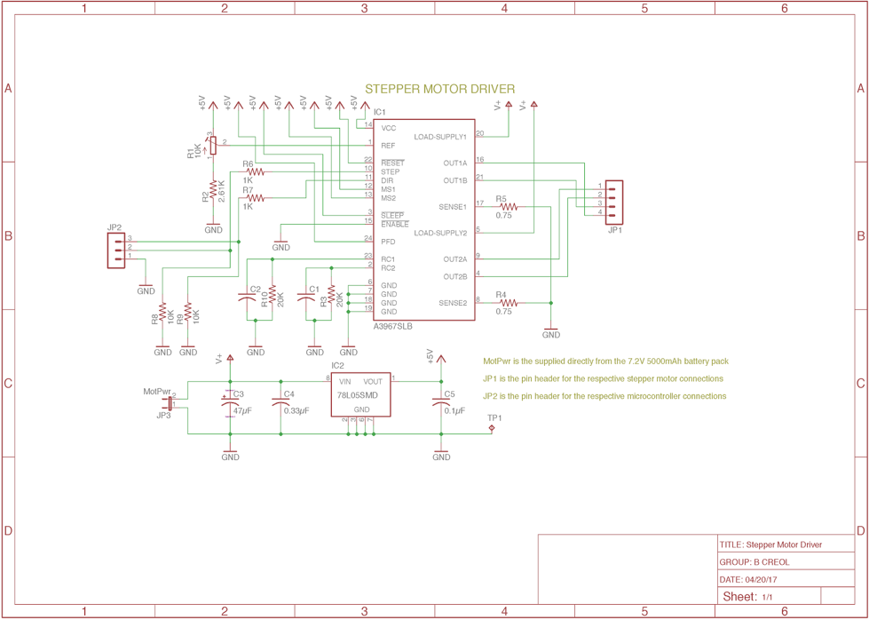
Stepper Motor Driver Schematic

Slide 28
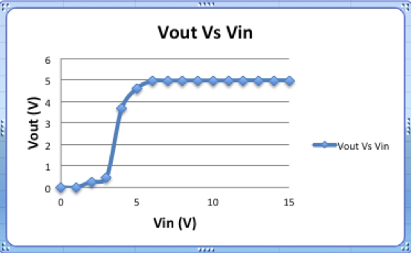
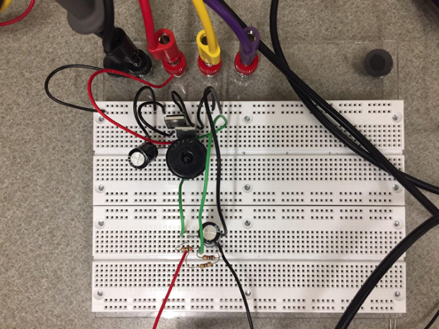
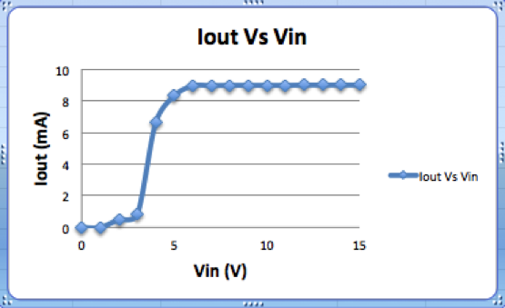
Switching Regulator Prototype
5V Switching Regulator (LM2576-ADJ)

Slide 29
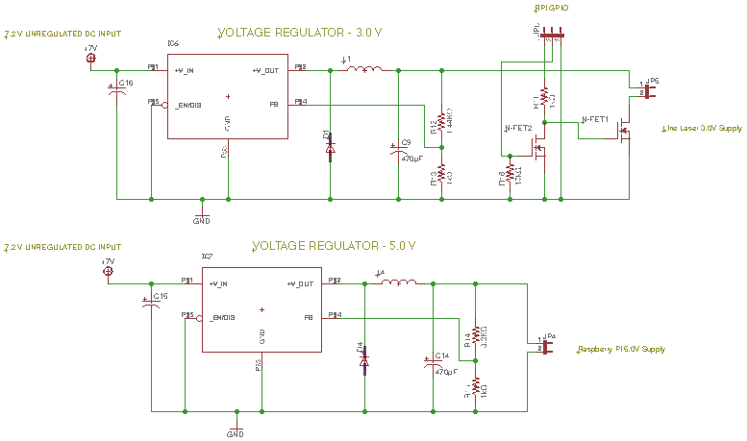
Power Management

Slide 30
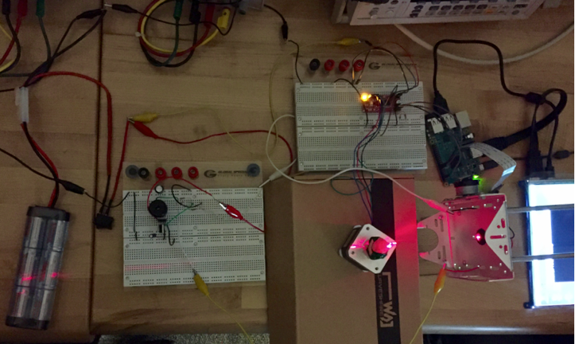
Initial Prototype Testing

Slide 31
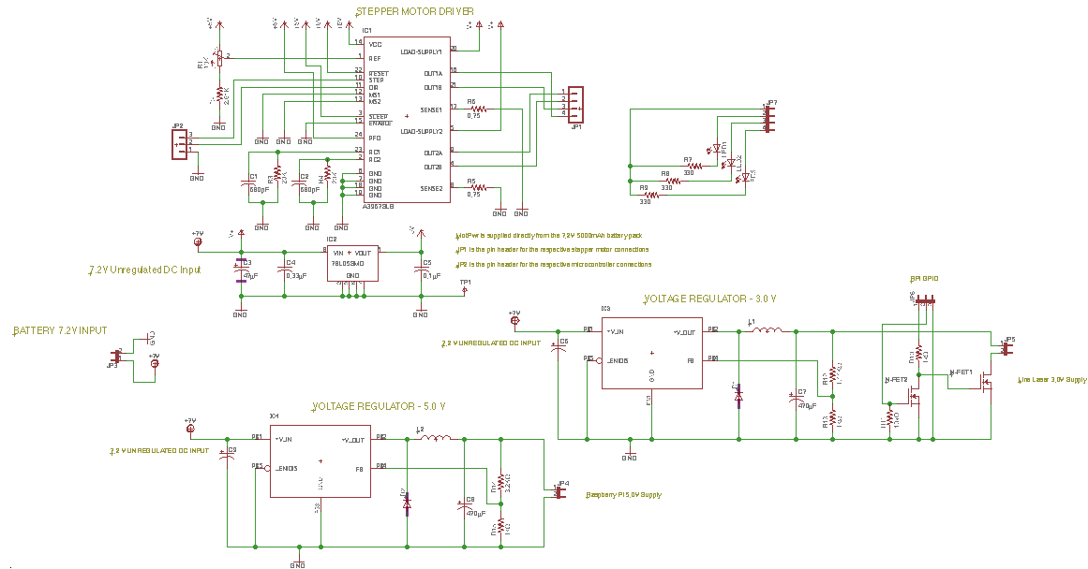
Full System Schematic

Slide 32
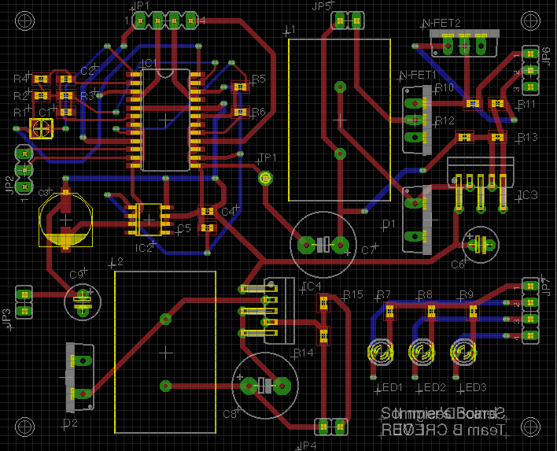
PCB

Slide 33
Administrative Content

Slide 34
Budget
Description | Quantity | Price/Unit | Item Total
PCB | 1 | $80.10 | $81.10
Laser | 1 | $23.95 | $23.95
Camera | 1 | $29.95 | $29.95
Microcontroller | 1 | $34.99 | $34.99
Battery Pack | 1 | $34.90 | $34.90
Battery Charger | 1 | $17.99 | $17.99
Stepper Motor | 1 | $16.95 | $16.95
Mounting Device | 1 | $4.95 | $14.85
Misc. Hardware | - | - | $20.00
Total |  |  | $274.68
Note: Equal Contributions by group members for total costs of project

Slide 35
Task Division
Name | Primary | Secondary
Power | Sommer | Isaias
Optics | Sam | N/A
Enclosure | Isaias | Sam
Software | Cary | Isaias/Sam

Slide 36
What We Would Improve?
Introduce multithreading to further reduce scan time
Improve meshing algorithm
Hardwire RPi GPIO pins on PCB
More robust calibration
Improve User Interface
Notes:
Cary - What’s next?
Finalizing and order the PCB. We hope to have that done by the end of next week.
As mentioned before, translating the point cloud extraction to opencv code.
Writing the software for bluetooth interfacing and transmission of the point cloud data.
Finalizing design for the container of the system, then begin its implementation.
Most importantly, testing. We want to make sure to allocate sufficient time for testing the system and verifying that is production ready before delivery.

Slide 37
Questions?
Notes:
All

